Slide 1
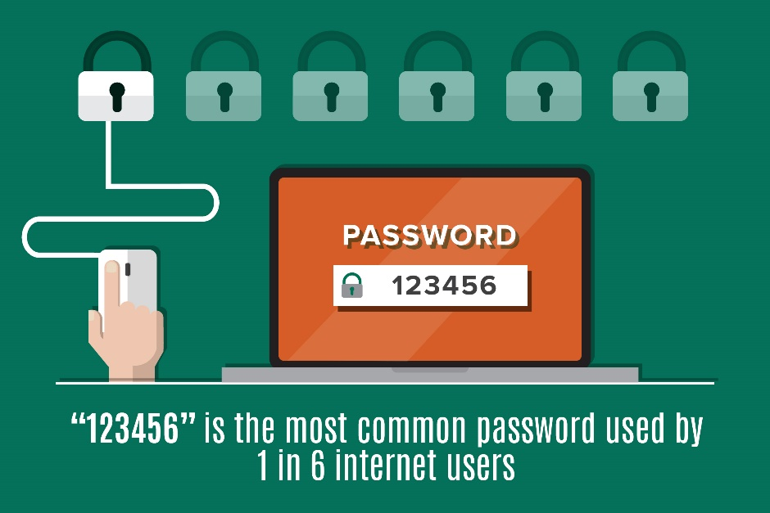
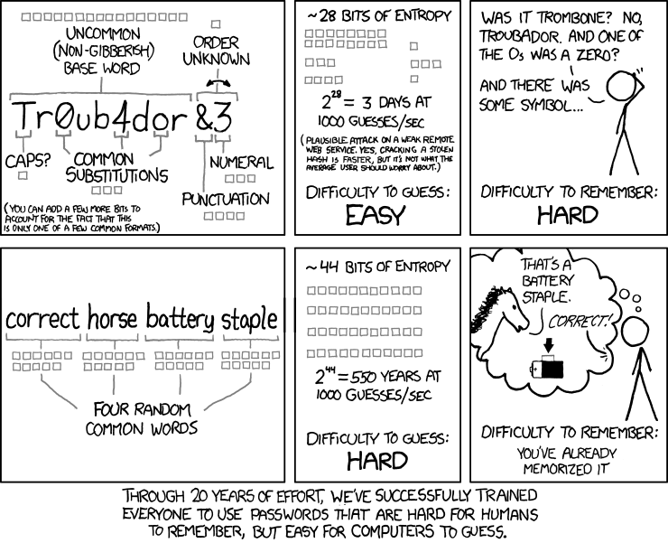


How Entropy and Length Affect Password Security
Kevin Allison, Alex Garrett, Michael Lyons, Hayley Norton
CS356 Computer Security
Fall 2017
Common Password Attacks
Brute Force
The most standard attack
The attacker systematically checks different password permutations until the user’s password is guessed
Dictionary
Many possible passwords, usually commonly-used passwords are stored in a file
The attacker enters each word in the password file, or dictionary, as the users password
Rainbow Table
When a user establishes a password on a system for the first time, it is hashed; that hash value is stored in a table. Every time the user enters the password, the hash value of what is entered is compared to the table. If it’s a match, access is granted
A rainbow table is precomputed to reverse the hash function and obtain the plaintext password
Preventing Password Attacks
It is common knowledge that having a strong password makes one less susceptible to password attacks. But what makes a password strong? At minimum, passwords shouldn’t be one’s name, birthday or any information that could easily be deduced. These are characteristics of a “strong password” as described by common websites:
Minimum of 8 characters
Includes at least one uppercase letter
Includes at least one number
Includes at least one special character
The combination of upper and lower case letters, numbers and special characters contribute to entropy.
But is entropy enough?
Haystacking: Another Tool to Strengthen Passwords
Haystacking is the process of padding passwords with special characters for the purpose of making the password longer. It was first described by Steve Gibson in his now iconic page, “How Big Is Your Haystack?” He states, “padding an easily memorized password with equally easy to remember (and enter) padding creates unbreakable passwords that are also easy to use.” To illustrate how this works, let’s take the base dictionary word “defenestrate” and add some padding to increase its length:
Add 7 question marks to the beginning ???????defenestrate
Add “<<<...>>>” to the end ???????defenestrate<<<...>>>
Capitalize the “s” ???????defeneStrate<<<...>>>
This final, 28-character password has about $1.07 ∗ {10}^{57}$ different possible combinations, and is fairly easy to remember. Compare its memorability to “D#yn0RTtQ4J7*iBxq$$*QqnoO*!J” and it’s plain to see why usability considerations sometimes dominate strict security considerations.
However, usability does come at a cost of entropy. If an attacker becomes wise to the idea of certain padding policies, such as appending a root word with a variety of symbols at different lengths with certain patterns, then they can begin to exploit the low-entropy predictability of padded passwords and crack them in much less time than their raw search space might suggest is possible. The challenge is creating a password that survives every dictionary attack and heuristic of an attacker and is on the exhaustive-search side of a dictionary attack. That is, a low-entropy password that is not exploited by an attacker can have easily-remembered length added for free, with increasing returns on security.
Our Experiment:
Rudimentary Haystacked Password Cracker
We wrote a password cracker in Python 3.6.1 to illustrate the potential downfalls of relying solely on haystacking for password security.
The basic structure of the program is as follows:
A user inputs a padded password, such as “....password!!!!”
The program loops until it cracks the password, performing the following steps each iteration:
Choose a random word from popular-passwords list
Choose a random-length prefix pad from a pad list
Choose a random-length suffix pad from a pad list
Increment guesses-made variable
Check if (prefix) + (word) + (suffix) matches the password
There are, however, several limitations to this program:
Pads and words chosen by the user must be in accompanying lists
Pads, if any, can only appear at the beginning and end of the word
Pads must be homogenous (prefix and suffix must each be comprised of the same symbol; prefix and suffix can be different)
Common substitutions, like “passw0rd”, cannot be accounted for
That being said, it does demonstrate an important point about password security—Even long passwords can be cracked if an attacker knows the template used to generate it. The graphs below show the time it took our program to guess a password over fifty iterations.
Therefore, padding something that’s easily guessable still
leaves you with a weak password.
Entropy: Randomness and Unpredictability
Entropy in passwords can simply be described as the randomness of a password. And central to this discussion of entropy is how we choose our passwords, or templates.
For example take the password “75john#”.
A template to produce this password might be:
digit | digit | common name | special character
However, it’s also possible that this password was generated with this template instead:
Pick 7 random symbols from every digit, letter, and punctuation symbol.
Because of the uncertainty regarding the template, entropy is relative to the attacker. If the attacker already knows your password, even if it’s a strong password like “jKWr#L9oe$5eEP7%”, the entropy is 0. Therefore, randomness in choosing a template is important.
Assuming the attacker does not know the chosen template, then the higher the entropy, the stronger the password. But how does one calculate a chosen password’s entropy? To answer that question, consider a password consisting of binary numbers, for example “01101”. There are 32 (2⁵) different passwords using this template.
The formula to calculate entropy is:
$$E=L\log_{2}{N}$$
E = Entropy
L = Length of password
N = Number of possible symbols
“01101” has an entropy of $E=5\log_{2}{2}=5$. This can be thought of as asking, “Is the first digit 0 or 1? Is the second digit 0 or 1?...” and so on. So in a sense, entropy condenses a password into a set of discrete, binary decisions. To see how this applies to actual passwords,
consider “cfxg”. Efficient questions to determine
each character split the possibilities in half each
time, much like a binary search.
Is the first character m or earlier?
Is the first character g or earlier?
Is the first character d or earlier?
Is the first character b or earlier?
Is the first character b? If yes, it is b,
if no, it is a.
As it turns out, the entropy for “cfxg” per symbol
is about 5, the number of questions asked in the
worse case scenario above. The overall entropy for “cfxg” is about 19, which is average sum of questions we had to ask about each symbol in the string.
Length - 16
Length - 25
Length - 26
Conclusion
Password policy is hard. What is the appropriate trade-off between security and ease-of-use? It’d be nice if everyone could memorize a long, random password and change it every week, but it just doesn’t work that way. There will always be incompetence or evil, so there will always be a need for security. Haystacking, by itself, is not the silver bullet of password security. Low entropy, or predictability, will in all likelihood eventually be exploited, especially if the stakes are high enough. But with a template that includes high entropy and long length from haystacking, passwords can be good enough.
Notes:
References:
https://www.grc.com/haystack.htm https://null-byte.wonderhowto.com/how-to/hack-like-pro-crack-passwords-part-1-principles-technologies-0156136/ https://pthree.org/2011/03/07/strong-passwords-need-entropy/ http://stats.distributed.net/projects.php?project_id=5 http://www.magmamater.cl/MatheComm.pdf https://www.youtube.com/watch?v=R4OlXb9aTvQ&list=FLhTFQFU0F5dXM9Io_2iE_Iw https://github.com/danielmiessler/SecLists

